Slide 1
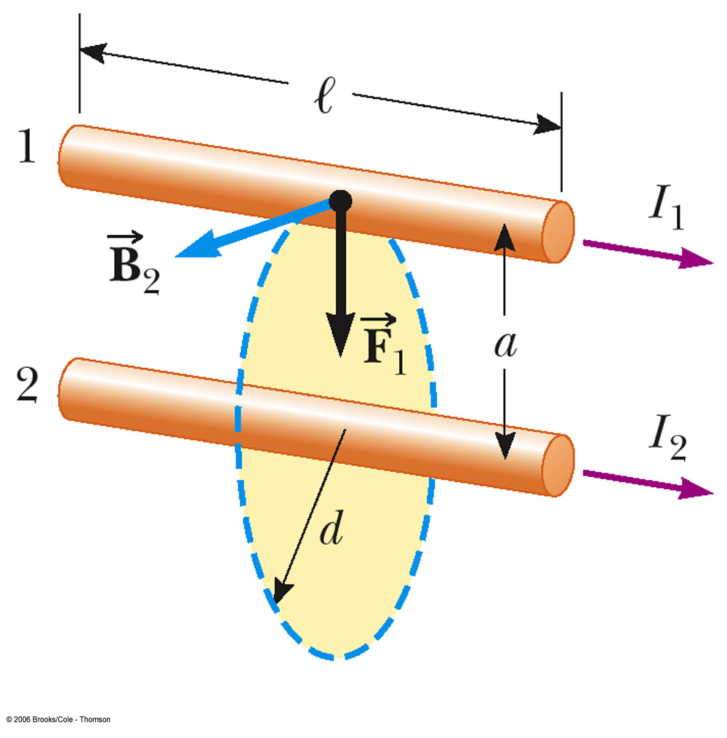
Magnetic Force Between Two Parallel Conductors
The force on wire 1 is due to the current in wire 1 and the magnetic field produced by wire 2
The force per unit length is:

Slide 2
1
L
B₁₂
I₁
2
F₁₂
d
I₂

Slide 3


Slide 4


Slide 5
Current Loop
I
b
a

Slide 6
Current Loop
I
B
b
a

Slide 7
B
I
B
F₁
a/2
b
I
F₂
a
Side View
Bottom View

Slide 8
Current Loop
I
B
b
a

Slide 9

Brushes
Commutator
N
S

Slide 10


Slide 11
Brushes
Commutator
N
S

Slide 12

Positive Brush
Commutator
Negative Brush
Reversal of current Direction

Slide 13
